Slide 1

BOOK REVIEW
MAKING OF A TEACHER-
The Journey Continues
Prof. Bholanath Dutta

Slide 2
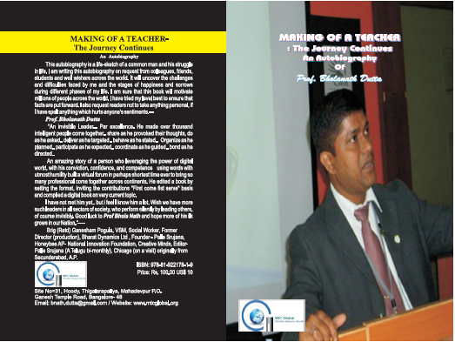
COVER PAGE

Slide 3
BOOK DETAILS
TYPE : AUTOBIOGRAPHY of Prof. Bholanath Dutta
AUTHOR: Prof. Bholanath Dutta
ISBN:978-81-922178-1-9
PRICE: INR 100, US$ 10
LENGTH: 7 CMS
WIDTH: 5 CMS
WEIGHT: 87 GMS

Slide 4
PHASE- I: THE EARLY DAYS OF MY LIFE
Youngest son of a village primary school teacher who hailed from Bangladesh in 1950 because of communal violence.
Poverty, four siblings, struggle at childhood.
Unable to study further after 10th due to poor financial condition

Slide 5
PHASE- II: THE JOURNEY AS A SOLDIER
Joined Indian Air Force at an early age as Rank and File.
Struggle of a soldier’s life.
Brief life at Air Force.
Hard work and study during stay at IAF.
A meaningful life in Defense.

Slide 6
PHASE- III: THE MAKING OF A TEACHER
Left Air Force on 25.06.2005 after serving 15 years.
Joined teaching profession.
Initial Struggle.
Score of 17 books, 100+ publication, consultancy, 50+ paper presentation, derivative books, 21 awards and appreciation.
Many More.

Slide 7
PHASE- IV: THE JOURNEY WITH MTC GLOBAL
Reason behind starting MTC Global.
Initial difficulties and challenges.
Stages of sorrows and happiness.
24/7 work behind it.
Support of many people.
Disagreement of many people.
Conflicting interest of many people.
Values and purpose.
Sankalp-2011 – struggle behind.

Slide 8
MORALE
IDEA IS NO ONE’S MONOPOLY
CLARITY IN PURPOSE
HUMILITY, HUMBLENESS
VALUES AND ETHICS
TEAM LEADER
EVERYONE IS A LEADER
EDUCATE, EMPOWER, ELEVATE
KNOWLEDGE SHARING

Slide 9
PEN IS PUT DOWN ON 28.08.2011
THANKS A LOT FOR ALL YOUR SUPPORT, MOTIVATION AND ENCOURAGEMENT IN MY ACADEMIC PURSUIT TOWARDS EXCELLENCE.

